Slide 1
Deliverable 1
Gun Violence
Team 3:
Sarah Bonna (Team Lead)
Brian Mahabir
Shivangi
Showndarya Madhavan

Slide 2
Question tackled
What is the rate of gun violence in District 4? How does this compare to the rest of the city?
Time period of work done
24th February - 1st March, 2023
Assumption made
District 4 is made up of Boston Police Districts B2, B3, C11 and E5

Slide 3
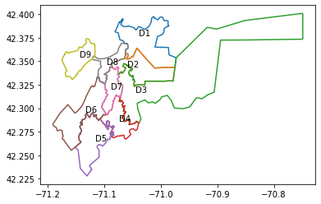
City council Shapefile dataset validation

Slide 4
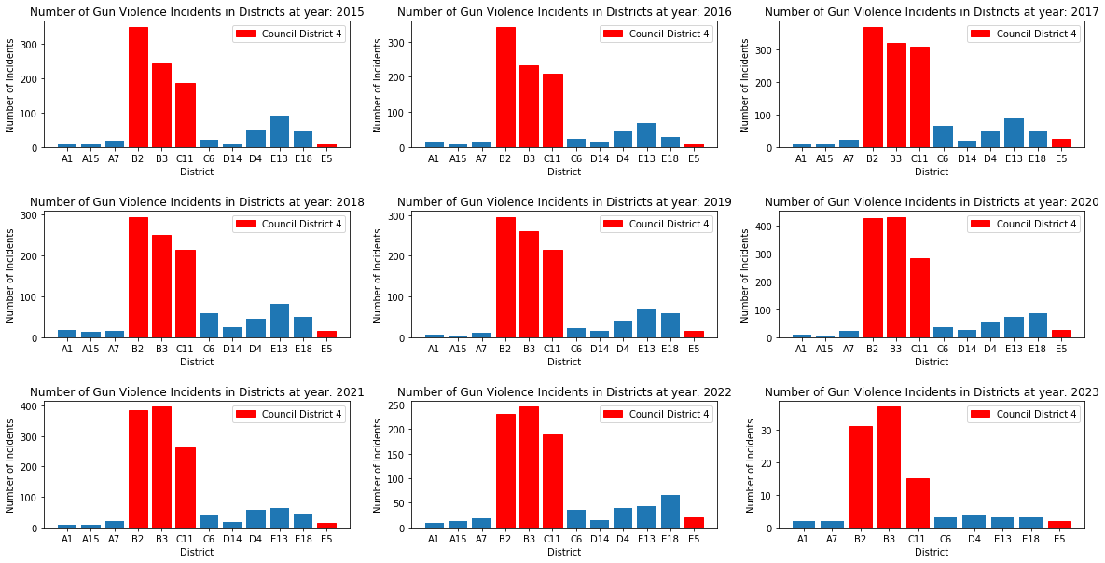
Rate of Gun Violence Incidents for Districts per Year

Slide 5
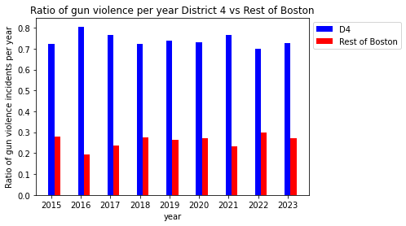
Ratio of Gun Violence in D4 vs Rest of Boston per year

Slide 6
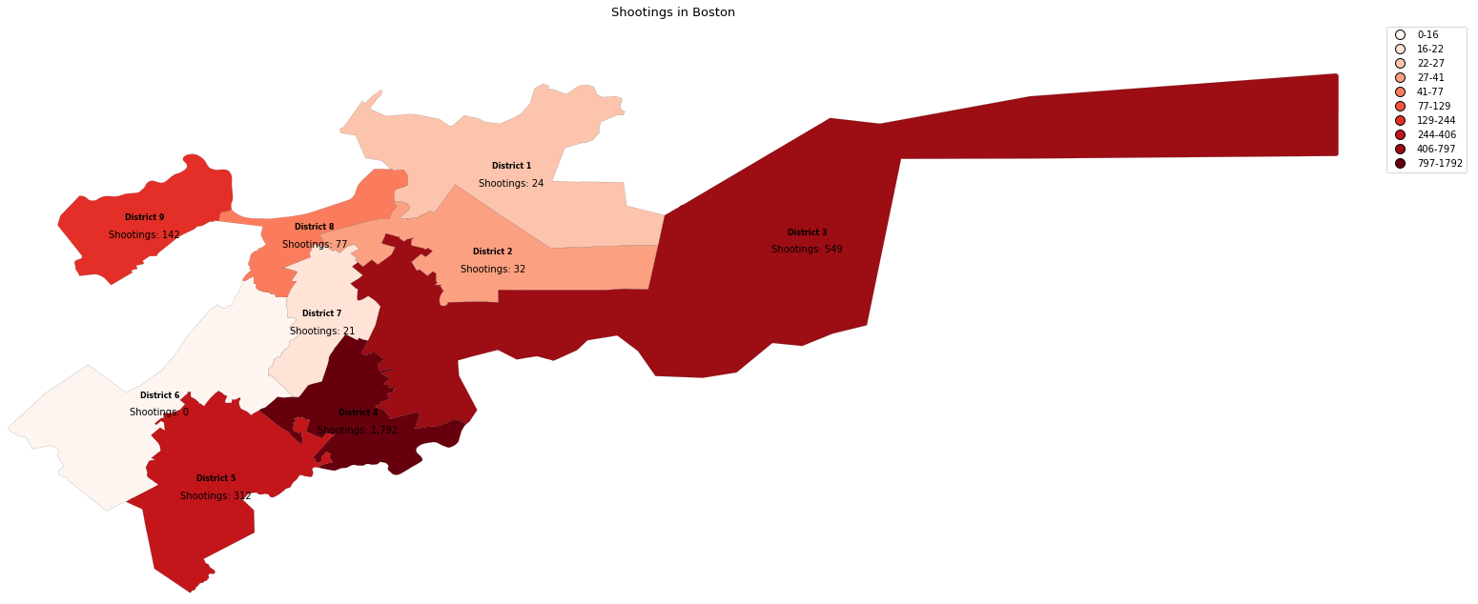
District wise intensity of gun violence w.r.t incidents count

Slide 7
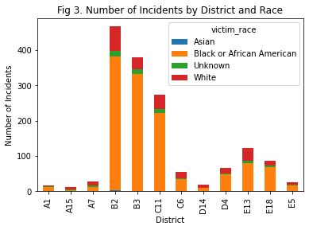
Number of Incidents by District and Race

Slide 8
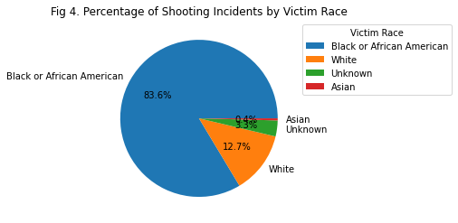
Percentage of Shooting Incidents by Victim Race

Slide 9
Questions?

